Slide 1
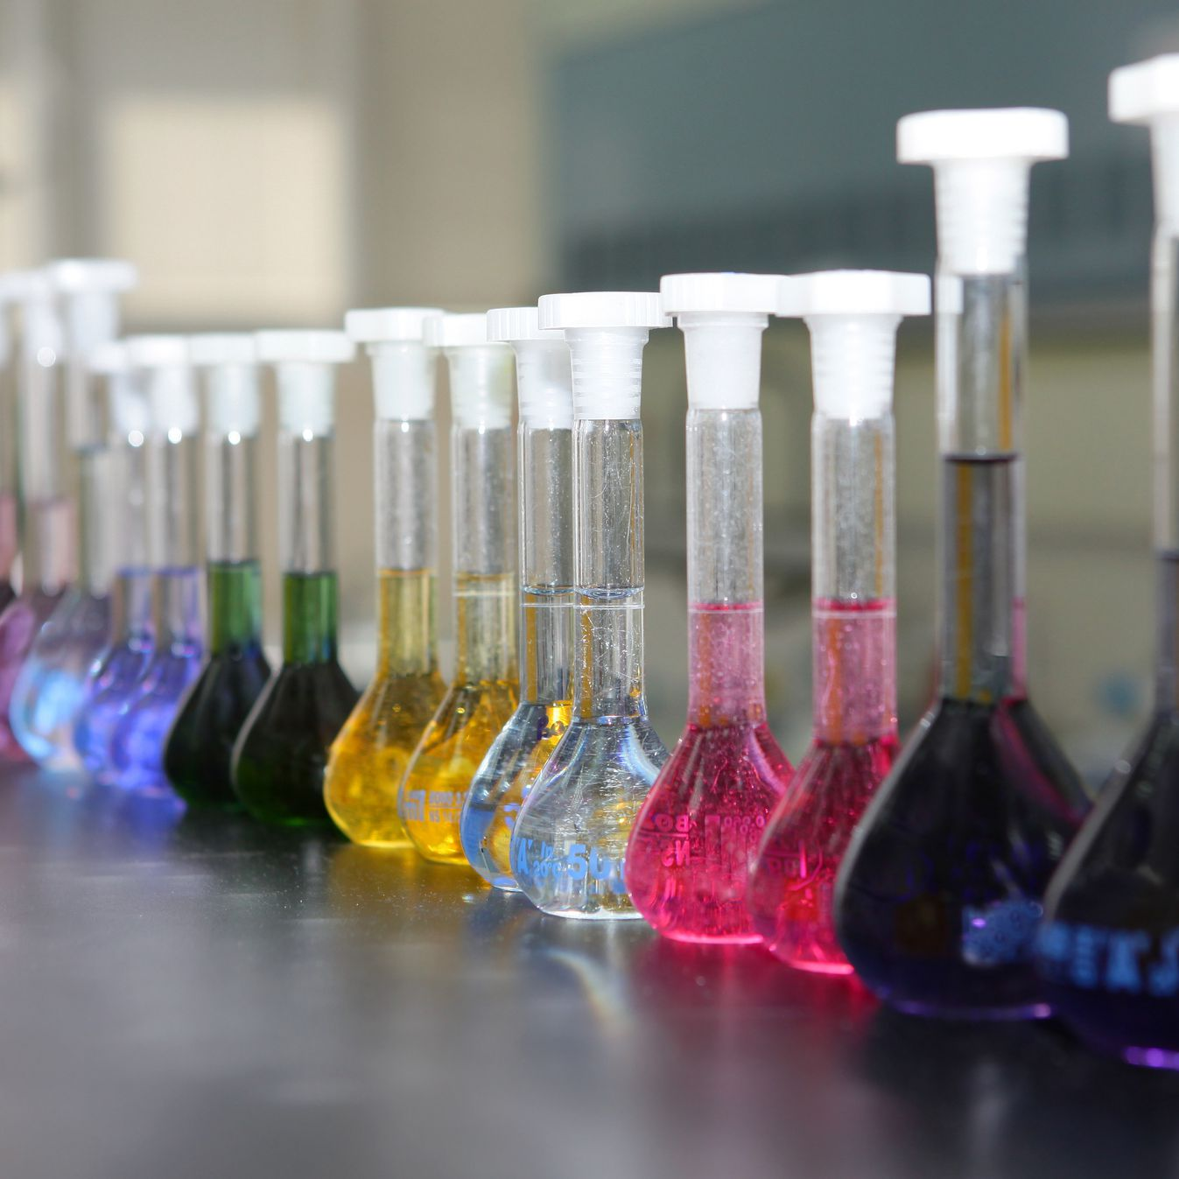
TITRATIONS
Standard solutions
ATAR Chemistry Unit 3 2021

Slide 2
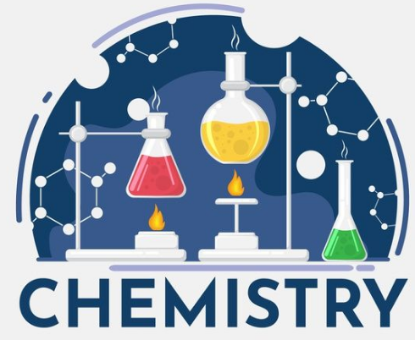
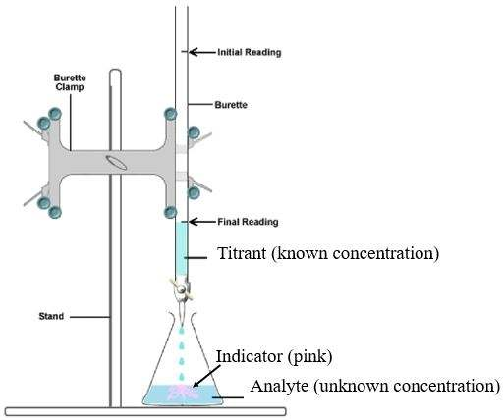
Recall
An acid base titration is a reaction between an acidic solution and a basic solution
To perform acid base titrations the concentration of one of the solutions must be accurately known. This is called the standard solution
The other concentration is the one that we are trying to determine. The purpose of a titration is to accurately determine the concentration of an unknown solution. This is called the unknown concentration
Either the analyte (in the flask) or the titrant (in the burette) needs to have a known concentration

Slide 3
Standard Solution
A standard solution has an accurately known concentration
Many substances that are used in acid base titrations have variable or changing conditions; they are affected by air as they absorb water; they are affected by carbon dioxide in the atmosphere; or the are unable to be obtained in a suitably pure form

Slide 4
Primary Standard
A primary standard is a substance that has the following criteria:
It can be obtained with a high degree of purity and has a known formula
Be sufficiently stable so that exposure to air does not readily change its water content or react with other gases
Have a relatively high molar mass (to minimise the effect of errors in weighing)
It undergoes reactions according to known chemical equations
Example: anhydrous sodium carbonate (Na₂CO₃) – [anhydrous means it is perfectly dry, contains no water] and hydrated oxalic acid (H₂C₂O₄.2H₂O)

Slide 5
Standardised solutions
Primary standard
Eg sodium carbonate Accurately prepare a solution of the primary standard with a precise concentration
Standardised acid solution
We do a titration between the primary standard and an acid solution
Then calculate the precise concentration of the acid
Standardised base solution
We do a titration between the standard acid solution and an unknown base
Then calculate the precise concentration of the base
High purity primary standards are expensive, so we make a small amount of primary standard and use it to standardize large amounts of cheaper acid and base solutions (typically hydrochloric acid and sodium hydroxide solution)

Slide 6
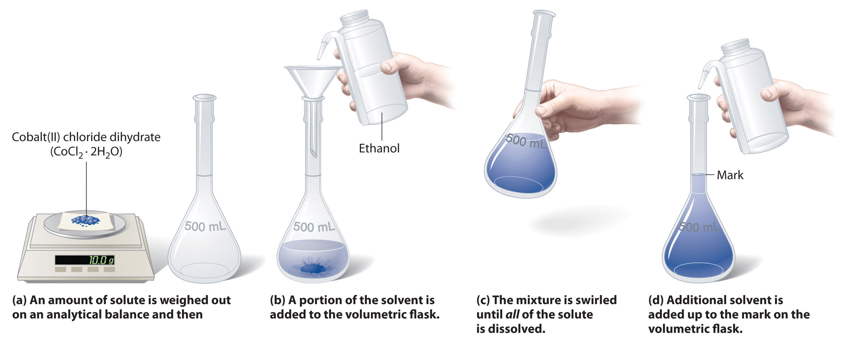
Preparing a primary standard
A solution of a primary standard is prepared by dissolving an accurately measured mass of the primary standard in an accurately known volume of solution (in a volumetric flask)

Slide 7
Preparing a primary standard
The general outline of the steps:
Accurately weigh a pure sample of the solid compound
Quantitatively transfer the solid into a volumetric flask
Half fill the volumetric flask with water and thoroughly mix
Continue adding water up to the graduation mark on the neck of the volumetric flask
Thoroughly mix again by stoppering the flask and inverting a number of times

Slide 8
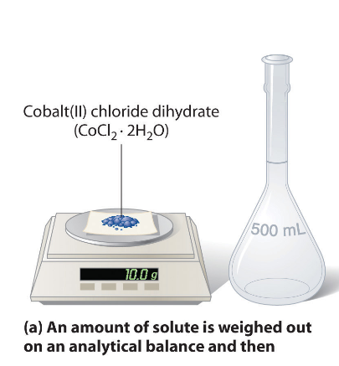
Preparing a primary standard
Step 1: weighing the solid primary standard compound
Use an accurate electronic balance that reads to two or three decimal places
Place a perfectly clean and dry beaker (100 mL) on the balance
Tare the balance so the display reads zero. Ensure no one bumps the desk, that window is closed and fans/aircon is turned off.
Use a spatula to careful add solid to the beaker *be very careful not to drop any solid on the weighing plate outside of the beaker*
Record the weight in your lab record with the associated error [for an electronic balance the error is ±0.01 g for a two decimal place balance]

Slide 9
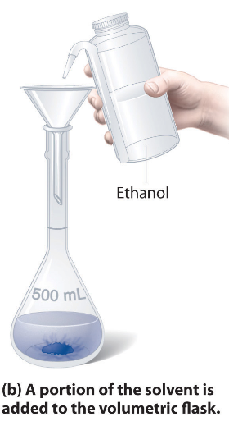
Preparing a primary standard
Step 2: quantitative transfer of the solid into the volumetric flask
This means that your do a complete transfer, 100 % of the solid is transferred into the volumetric flask.
Place the flask on a flat surface and put a funnel on the top
Carefully pour the solid into the flask *do not use a spatula at any point in this procedure*
Add a small amount of deionized water to the beaker, swirl gently then pour it into the funnel *it is best to hold the funnel a little up from the flask so it drains properly*
Repeat the rinse, add more water to the beaker, swirl, pour into flask
Gently use you DI water bottle to rinse around the inside of the funnel

Slide 10
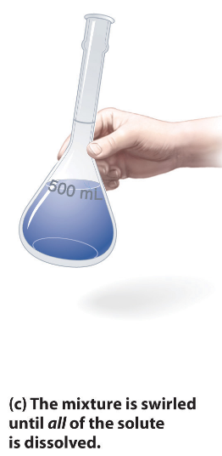
Preparing a primary standard
Step 3: half fill the volumetric flask with DI water and swirl to dissolve all of the solid
Half fill the volumetric flask with DI water
Place the tight-fitting plastic stopper on the top of the flask
Gently swirl the flask until all of the solid has dissolved *do not invert the flask as you might get solid particles stuck to the bottom of the lid or above the level of the solution*

Slide 11
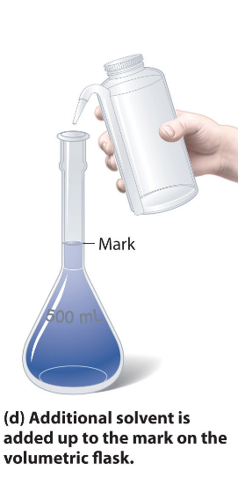
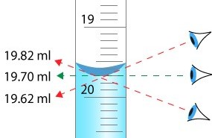
Preparing a primary standard
Step 4: Remove the stopper and carefully fill the volumetric flask with DI water up to the graduation mark on the neck of the flask.
Use the DI water bottle to fill the flask up until the solution reaches the thin neck
Use a plastic pipette to then continue adding water until the volume of the flask is at the graduation mark **the bottom of the meniscus has to be exactly on the line otherwise you have to start all over again**
NOTE – parallax error is a big source of error here, you need to make sure you are looking straight at the line as you add the final few drops of water

Slide 12
Preparing a primary standard
Step 5: Thoroughly mix the solution by replacing the stopper and then while holding the stopper invert the flask a number of times
Make sure the stopper properly fits the flask you are using
Fold the stopper and neck of the flask with one hand and the bottom of the flask with your other hand (to support the weight)
Gently invert (flip upside down) the flask then back to the right way up
Repeat this five or six times at least to ensure that the solution is thoroughly mixed (a homogenous concentration throughout the solutions)

Slide 13
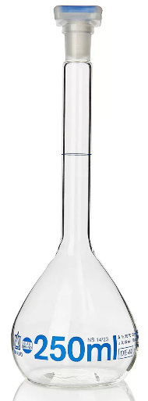
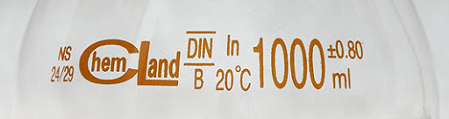
Preparing a primary standard
Step 6: record the volume of the Primary standard in your lab record with the associated error
Record the final volume of the Primary standard solution
The error for your volumetric flask should be written on the flask itself.

Slide 14
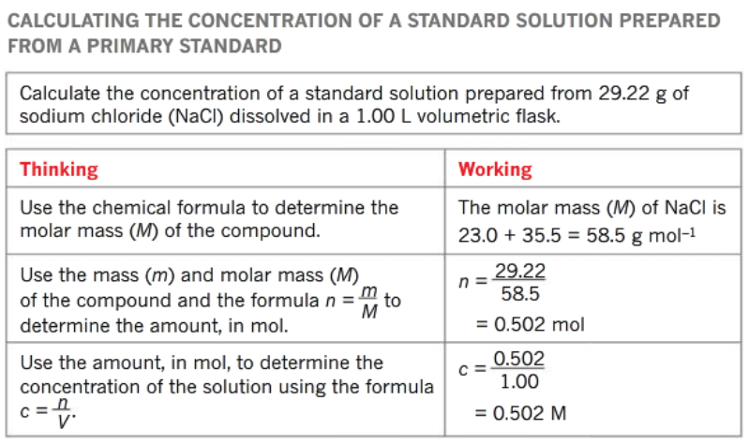
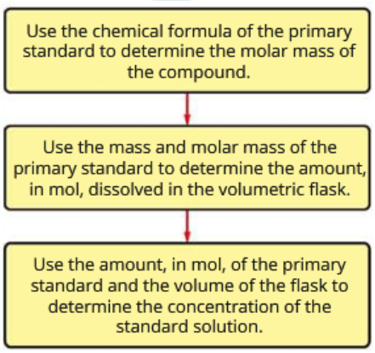
Preparing a primary standard
Step 7: calculate the concentration of the Primary standard solution

Slide 15
Preparing a primary standard
Prepare your primary standard following the steps outlined in Experiment 12 (STAWA). We will be using this Primary standard in our next lesson to standard a hydrochloric acid solution.

Slide 16
Diluting a solution
Weighing a large quantity of solid is more accurate than weighing a very small quantity
We sometimes make a Primary Standard with a very high concentration and then dilute it before using it in a titration
We need to know how to calculate the concentration of a solution when the process involves a dilution

Slide 17
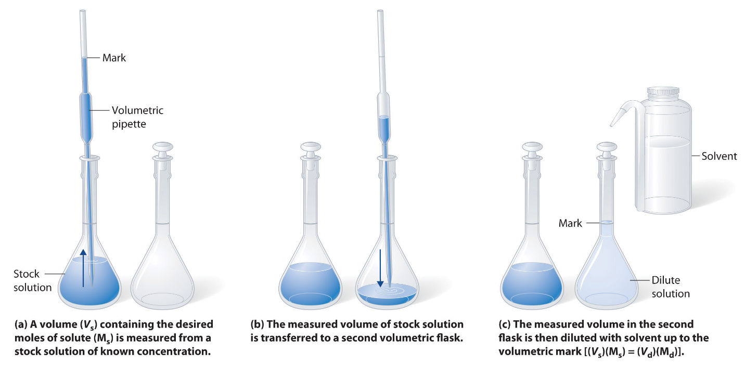
Diluting a solution

Slide 18
Diluting a solution
We use a pipette to take an exact volume of the solution, this is called an aliquot
We transfer the aliquot to a new volumetric flask
We fill this flask with DI water up to the graduation mark and thoroughly mix the new, diluted solutions
Solution 1: we know the concentration and we know the volume so we can calculate number of moles of solute present.
Solution 2: must have the same number of moles of was in the aliquot, so we know the number of moles and the final volume so we can calculate the new concentration

Slide 19
Diluting a solution
A simple way to calculate the new concentration is to use this equation:
C₁V₁ = C₂V₂
C1 = concentration of original solution (mol/L)
V1 = volume of aliquot (mL) [e.g. if use a 25 mL pipette then it is 25 mL]
C2 = concentration of the diluted solution (mol/L)
V2 = volume of the final solution (mL) [e.g. if using a 250 mL volumetric flask then it is 250 mL]

